Slide 1
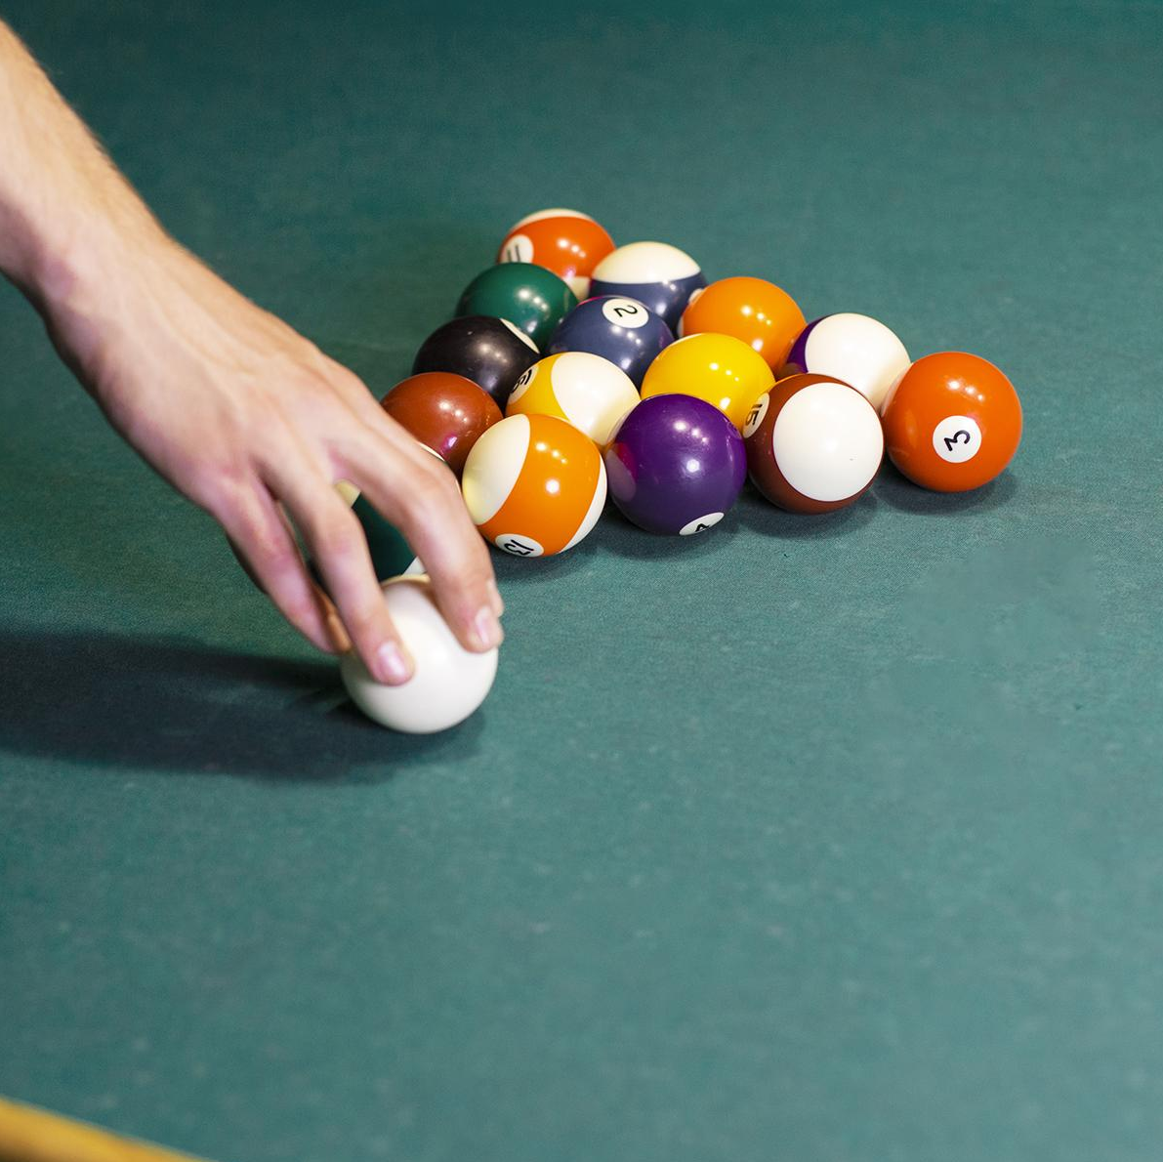
POOl Game C174C
Avalon Vinella, Mohsen Fayyaz,
Haniyeh Ehsani Oskouie, Benet Oriol Sabat

Slide 2
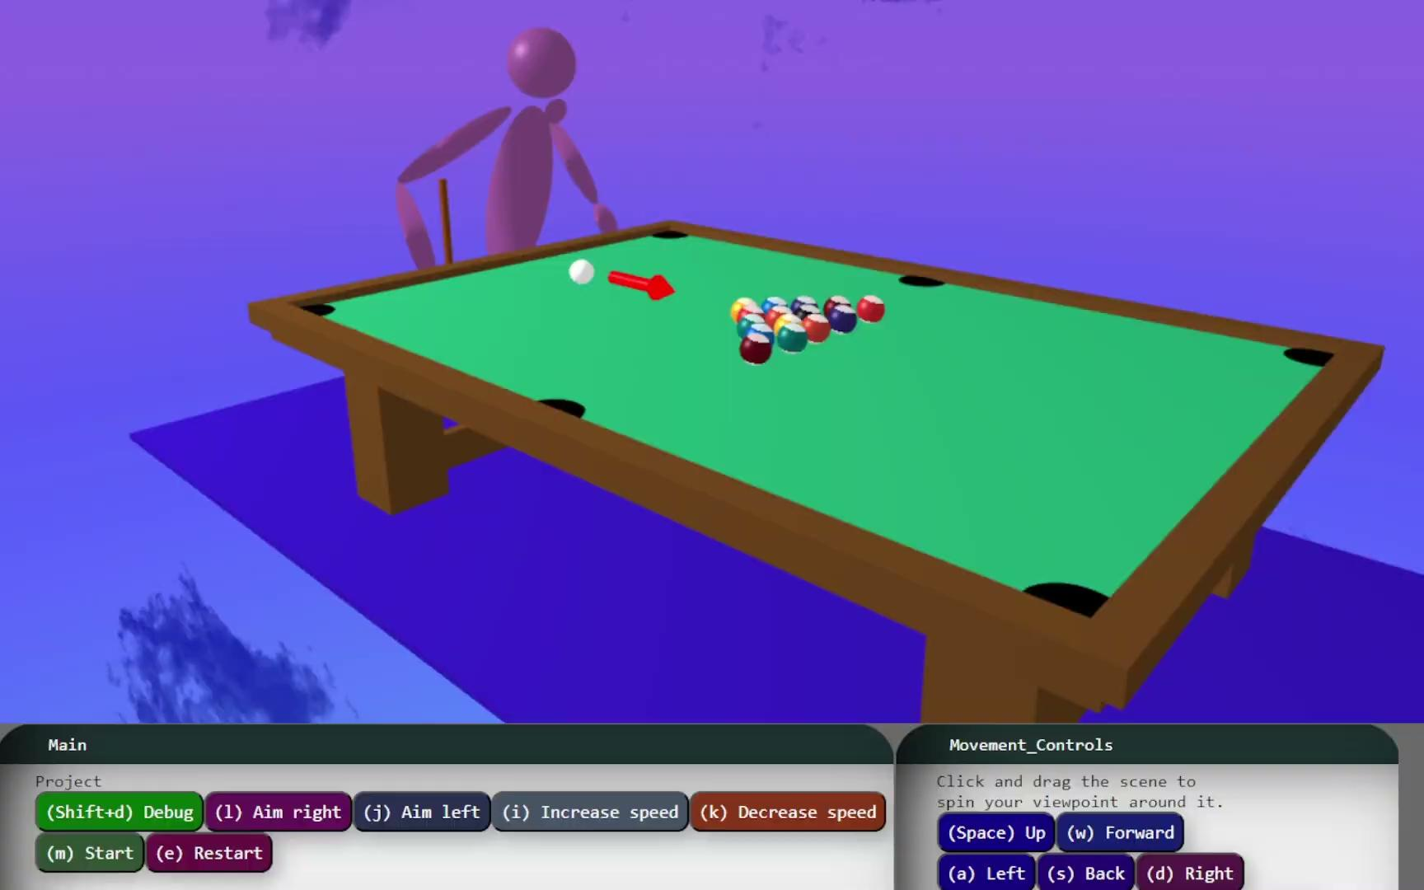

Description
The pool game:
The user defines the direction and velocity of their shot
The articulated hand hits the ball using the cue
The balls move and collide realistically
Ball explodes on hole collision
Can reset ball positions

Slide 3

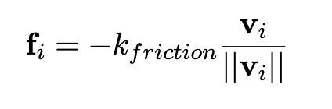


🎱 Ball Dynamics
For each ball we have:
We use symplectic integration
Coulomb friction model:
Position is updated using this formula:
We rotate the balls utilizing:

Slide 4
🎱 Ball Collisions
Collision between ball and wall

Slide 5
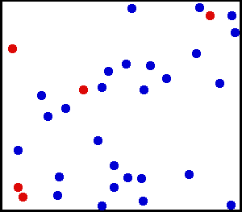
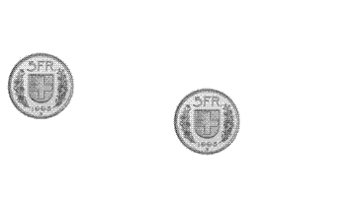
🎱 Ball Collisions
Collision between balls are same-mass perfect elastic collisions
  Velocity component orthogonal to collision direction is kept the same
  Velocity component parallel to collision direction is swapped between balls.

Slide 6
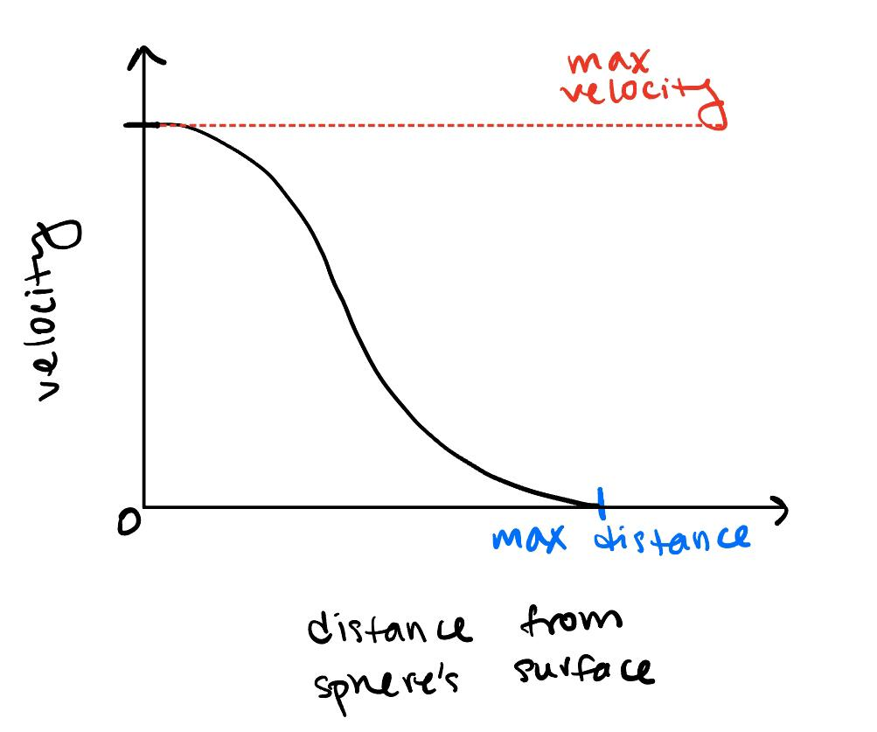

💥Explosion Simulation
Place equally distributed particles around surface of a sphere
Define an “eased” velocity field that radiates outward from the center of the sphere
  Sinusoid relative to the particle’s distance from the surface
Particle size decreases linearly as it travels away from the surface
Ends once particle velocities have fallen below a certain threshold

Slide 7
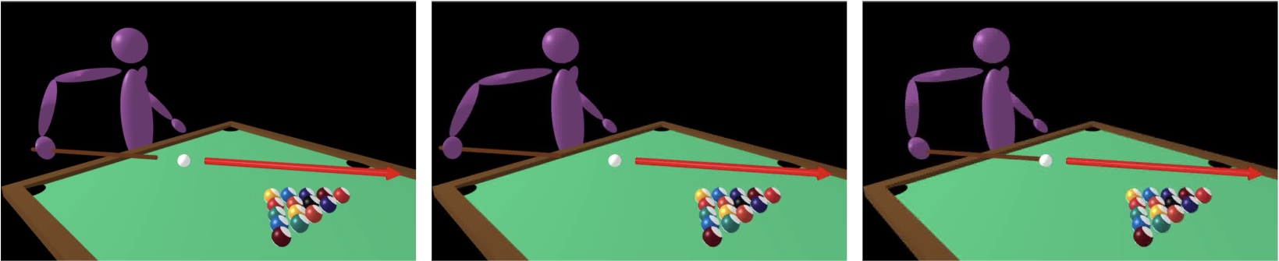
🏒Cue Movement &
🧍Articulated-Body Kinematics
We animate the cue to execute a distinct pull-back motion followed by a smooth forward movement towards the ball using Hermite spline
The speed of the cue’s motion corresponds directly to the user’s input
The cue adjusts its orientation to align with the intended angle
We apply inverse kinematics to achieve the desired cue-holding posture
We limit the angles of each of the joints to enhance the overall believability of the simulation

Slide 8
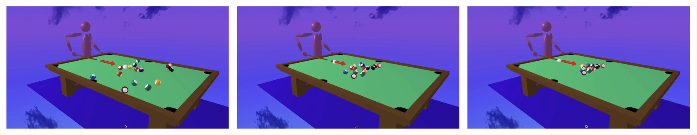
🔄Reset Positions
The balls gradually return to their initial positions through the utilization of multiple splines
Each ball is assigned a specific spline
The velocities of the balls are controlled using a sinusoidal function

Slide 9
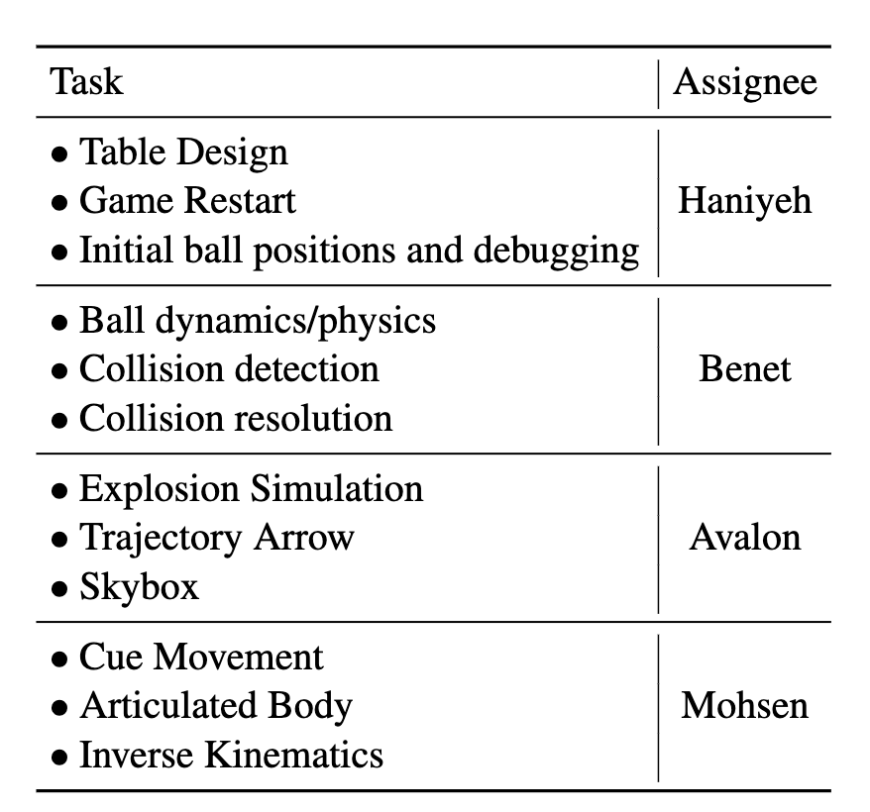
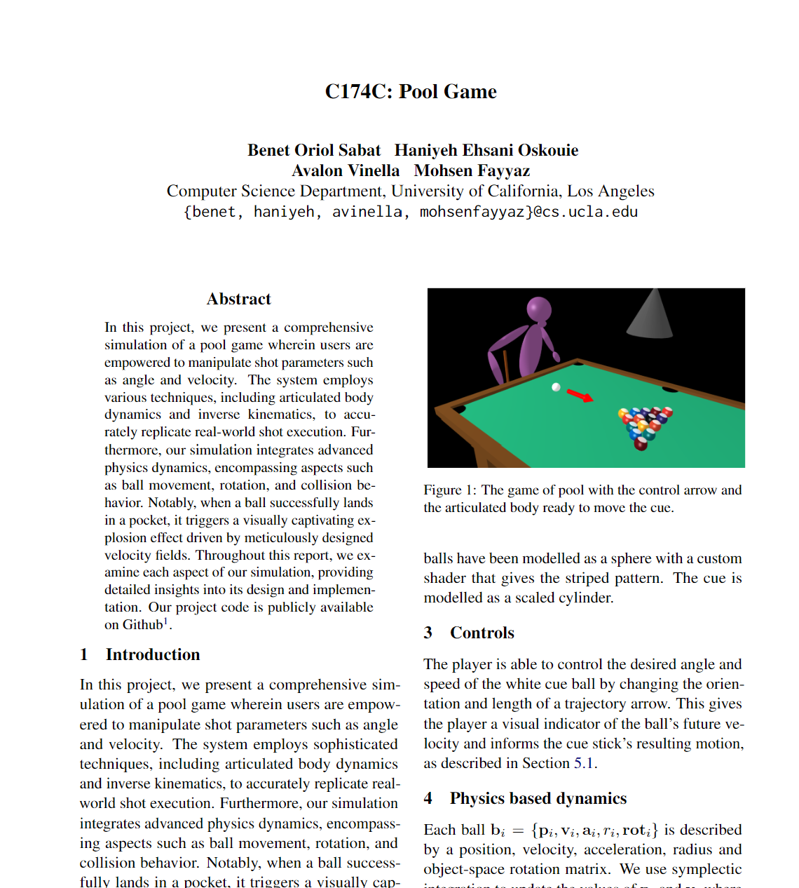
Tasks

Slide 10
DEMO

Slide 11
THANKS!
Do you have any questions?
CREDITS: This presentation template was created by Slidesgo, including icons by Flaticon, infographics & images by Freepik

Slide 12
Algorithms
Particle Simulation
Collisions
Splines
Articulated kinematics
Simulation of the balls' dynamics (x(t), v(t), friction, …)
Explosion simulation
Collision Detection & Collision Resolution
Cue movement
Balls moving to initial position on rest
A human arm moves the cue according to inverse kinematics

Slide 13
Creativity
?

Slide 14
Tasks
Keyboard (quick+fine grained) + indicator [Avalon] ✅
Good looking table [Haniyeh]✅
  Init balls position [Hanieyh] ✅
Inverse Kinematics (separate cue) [Mohsen] ✅
Rotate the balls with velocity [Benet] ✅
Textured Balls [Benet] ✅
Hole Detection and going down (explode) ✅
Good looking Human Model
Friction [Benet] ✅
Moving the human
Setting the ball on fire
Celebration
Textures
Game dynamics (start, reset, random ball, triangle position, ¿points?…)

Slide 15
Little optional tasks
Scale up the strength of the white ball (default before increasing arrow should be stronger)
The white ball should appear again after fallen into the whole
the cue follows a more complex spline when hitting the ball (simply along the long axis but something slightly more realistic)
Making the left hand reach the top of the cue (might not need inverse kinematics)

Slide 16
Ball collisions
Collision of two balls can be detected if the distance between the centers is smaller than the sum of their radius.
Collision resolution is a perfect elastic collision [1].
We define collision direction as the vector between the two balls at the moment of direction.
Velocity components normal to the collision direction remain unchanged.
Velocity components parallel to the collision direction are swapped between the two balls (assuming same-mass balls).
[1] https://en.wikipedia.org/wiki/Elastic_collision#Two-dimensional_collision_with_two_moving_objects

Slide 17

Friction.
We model friction as a constant force in the direction opposite to the velocity.

